Slide 1
ProgressGrid
Track. Improve. Achieve.

Slide 2
Our Team
S.No
Name
RA Number
1
Hemanth Kasireddy
RA2511056010022
2
G Hima Sai
RA2510056010011
3
D Naga
RA2511056010020
4
B Naveen
RA2511056010009

Slide 3
PROBLEM STATEMENT
With the increasing demands of academics, professional work, and personal responsibilities, individuals often find it challenging to maintain consistency in their daily activities and monitor their overall productivity. Although several productivity applications are available, most of them focus only on task completion or habit tracking, without providing a unified platform to measure, analyze, and improve daily performance.
The absence of a structured system makes it difficult for users to evaluate their progress, identify productivity trends, and make informed decisions to achieve their short-term and long-term goals. Furthermore, many existing applications lack intuitive visual analytics and personalized insights that encourage continuous improvement.
Therefore, there is a need for an integrated productivity management system that enables users to organize daily tasks, assign priority-based weights, calculate daily productivity as a measurable score, and visualize weekly and monthly performance through interactive dashboards and analytical reports. Such a system promotes better time management, self-discipline, and data-driven personal development.

Slide 4
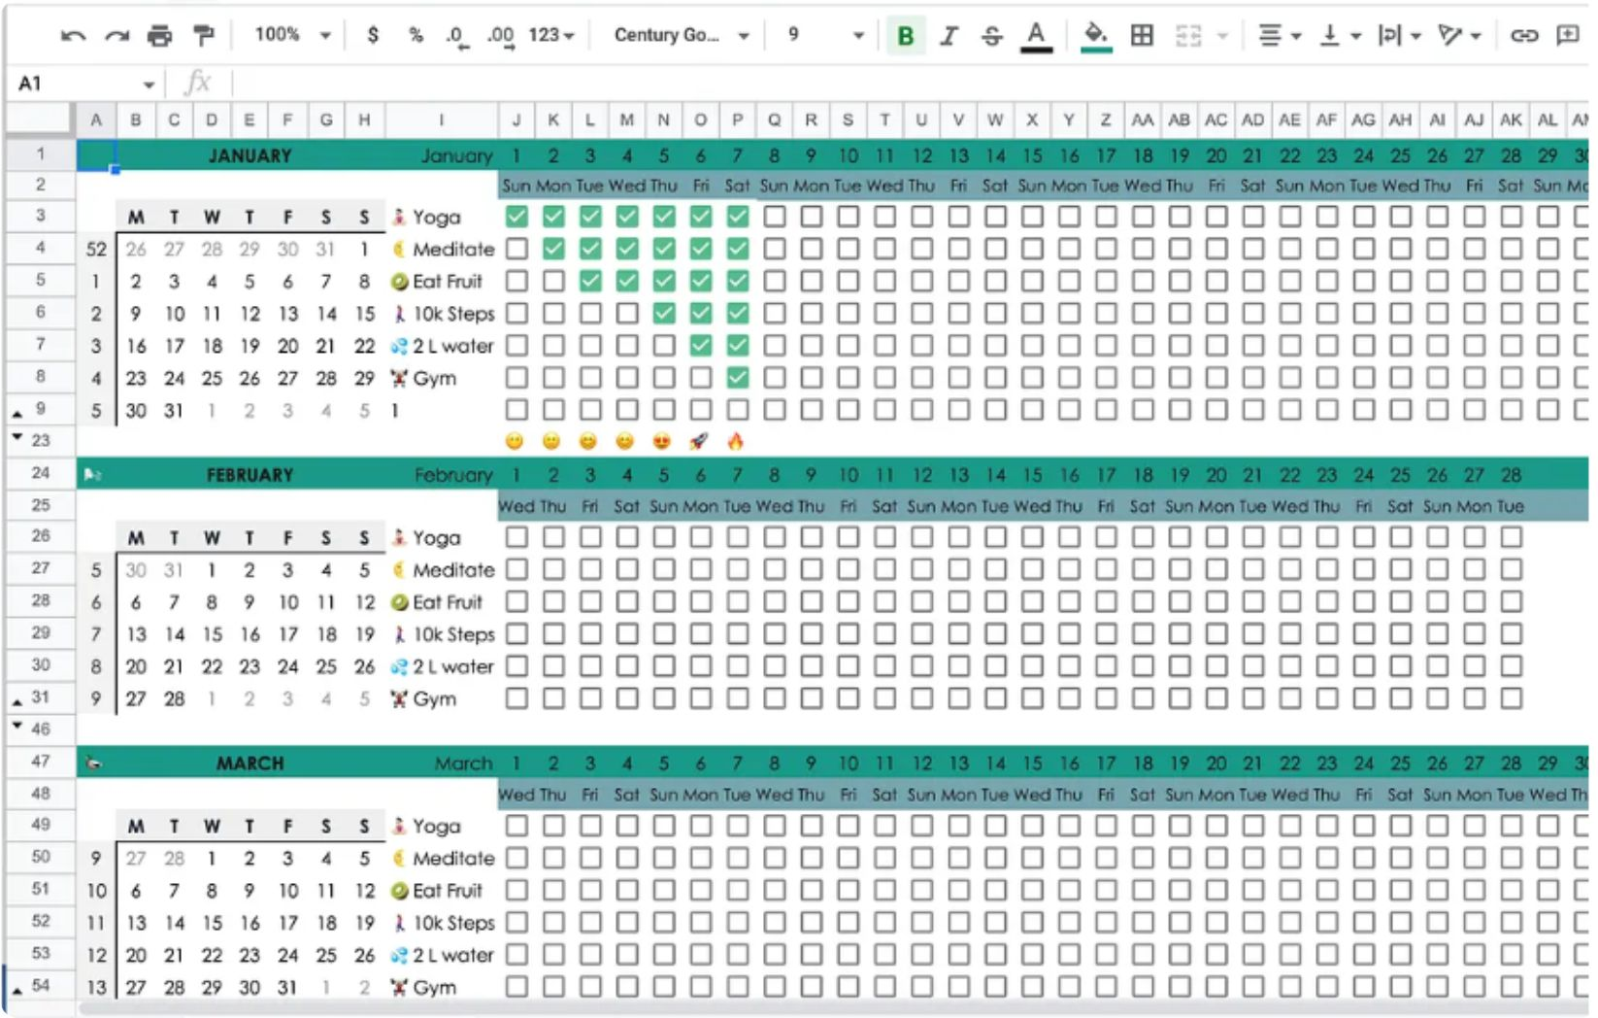
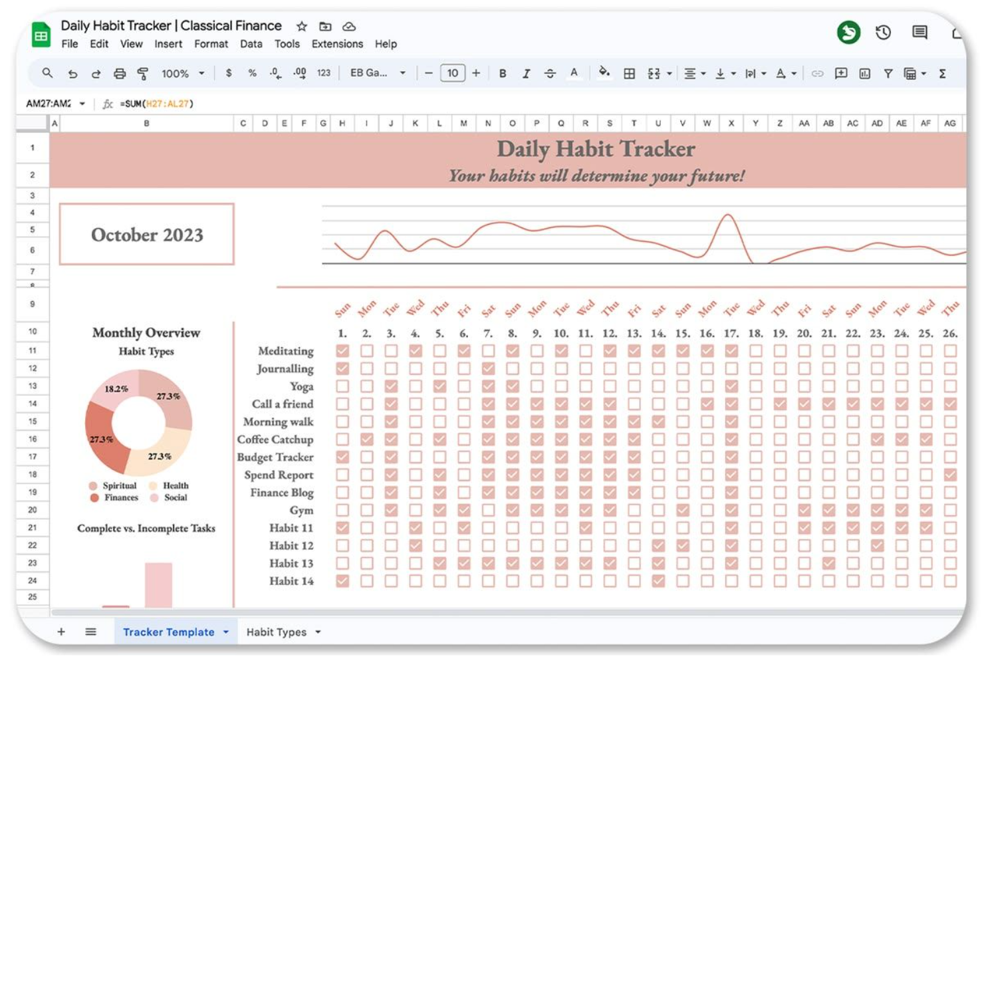
USER INTERFERENCE

